Slide 1
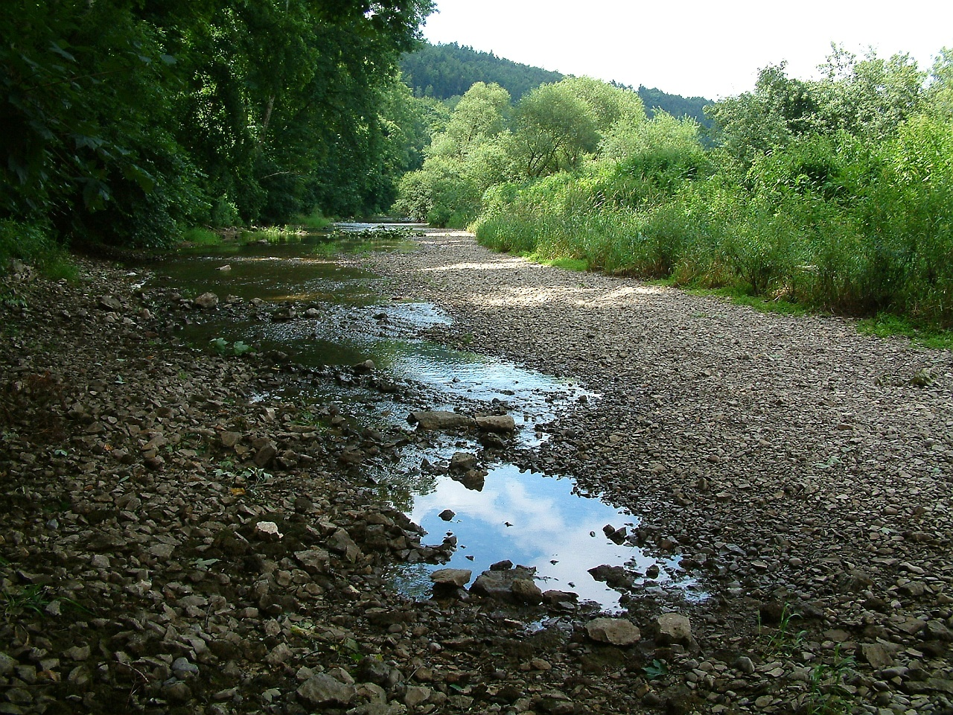
Drainage reorganization
The epic battle between Rhine and Danube

Slide 2
baselevel
Base level is the lowest elevation to which a river flows, and dictates the lowest elevation to which it can erode
Ultimate base level = sea level (not always!)
Local base level = local depositional basin

Slide 3
Chi
Streams erode more when they are
Steeper
Have more drainage area/discharge
Chi integrates upstream → long stream → high chi
Chi is reciprocal of drainage area → more drainage area → lower chi

Slide 4
Chi
Streams erode more when they are
Steeper
Have more drainage area/discharge
Chi integrates upstream → long stream → high chi
Chi is reciprocal of drainage area → more drainage area → lower chi
High or low chi basin?

Slide 5
Chi
Streams erode more when they are
Steeper
Have more drainage area/discharge
Chi integrates upstream → long stream → high chi
Chi is reciprocal of drainage area → more drainage area → lower chi
High chi – low erosion
low chi – high erosion

Slide 6
Chi
Streams erode more when they are
Steeper
Have more drainage area/discharge
Chi integrates upstream → long stream → high chi
Chi is reciprocal of drainage area → more drainage area → lower chi
Divide motion

Slide 7
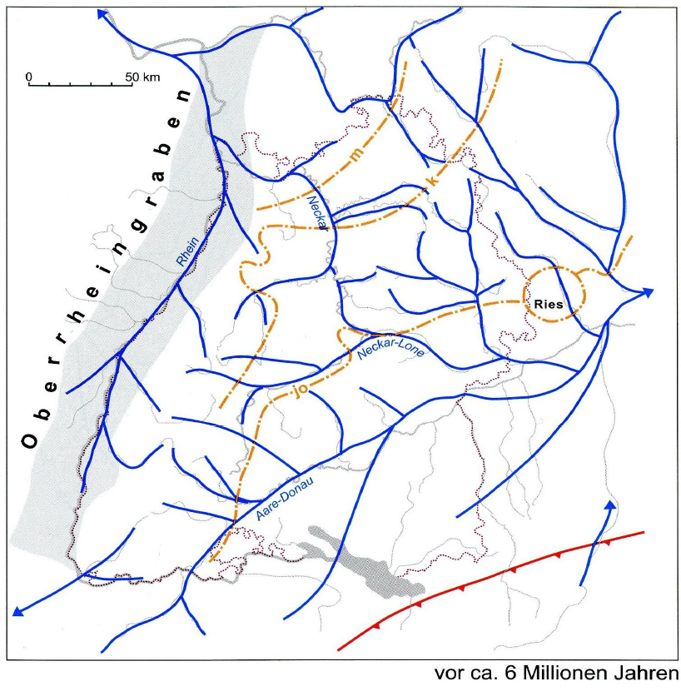
Drainage network of southwestern Germany 6 Mio years ago
Simon 2010

Slide 8
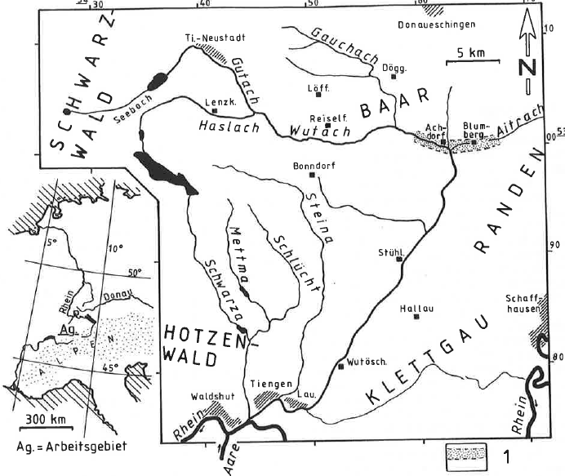
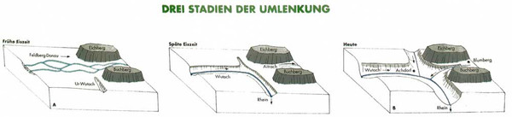
Wutach capture
Hebestreit 1996

Slide 9
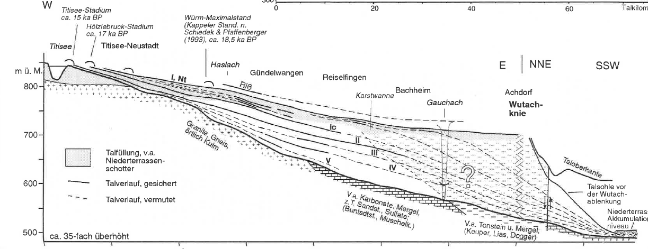
Wutach capture
Hebestreit 1996

Slide 10
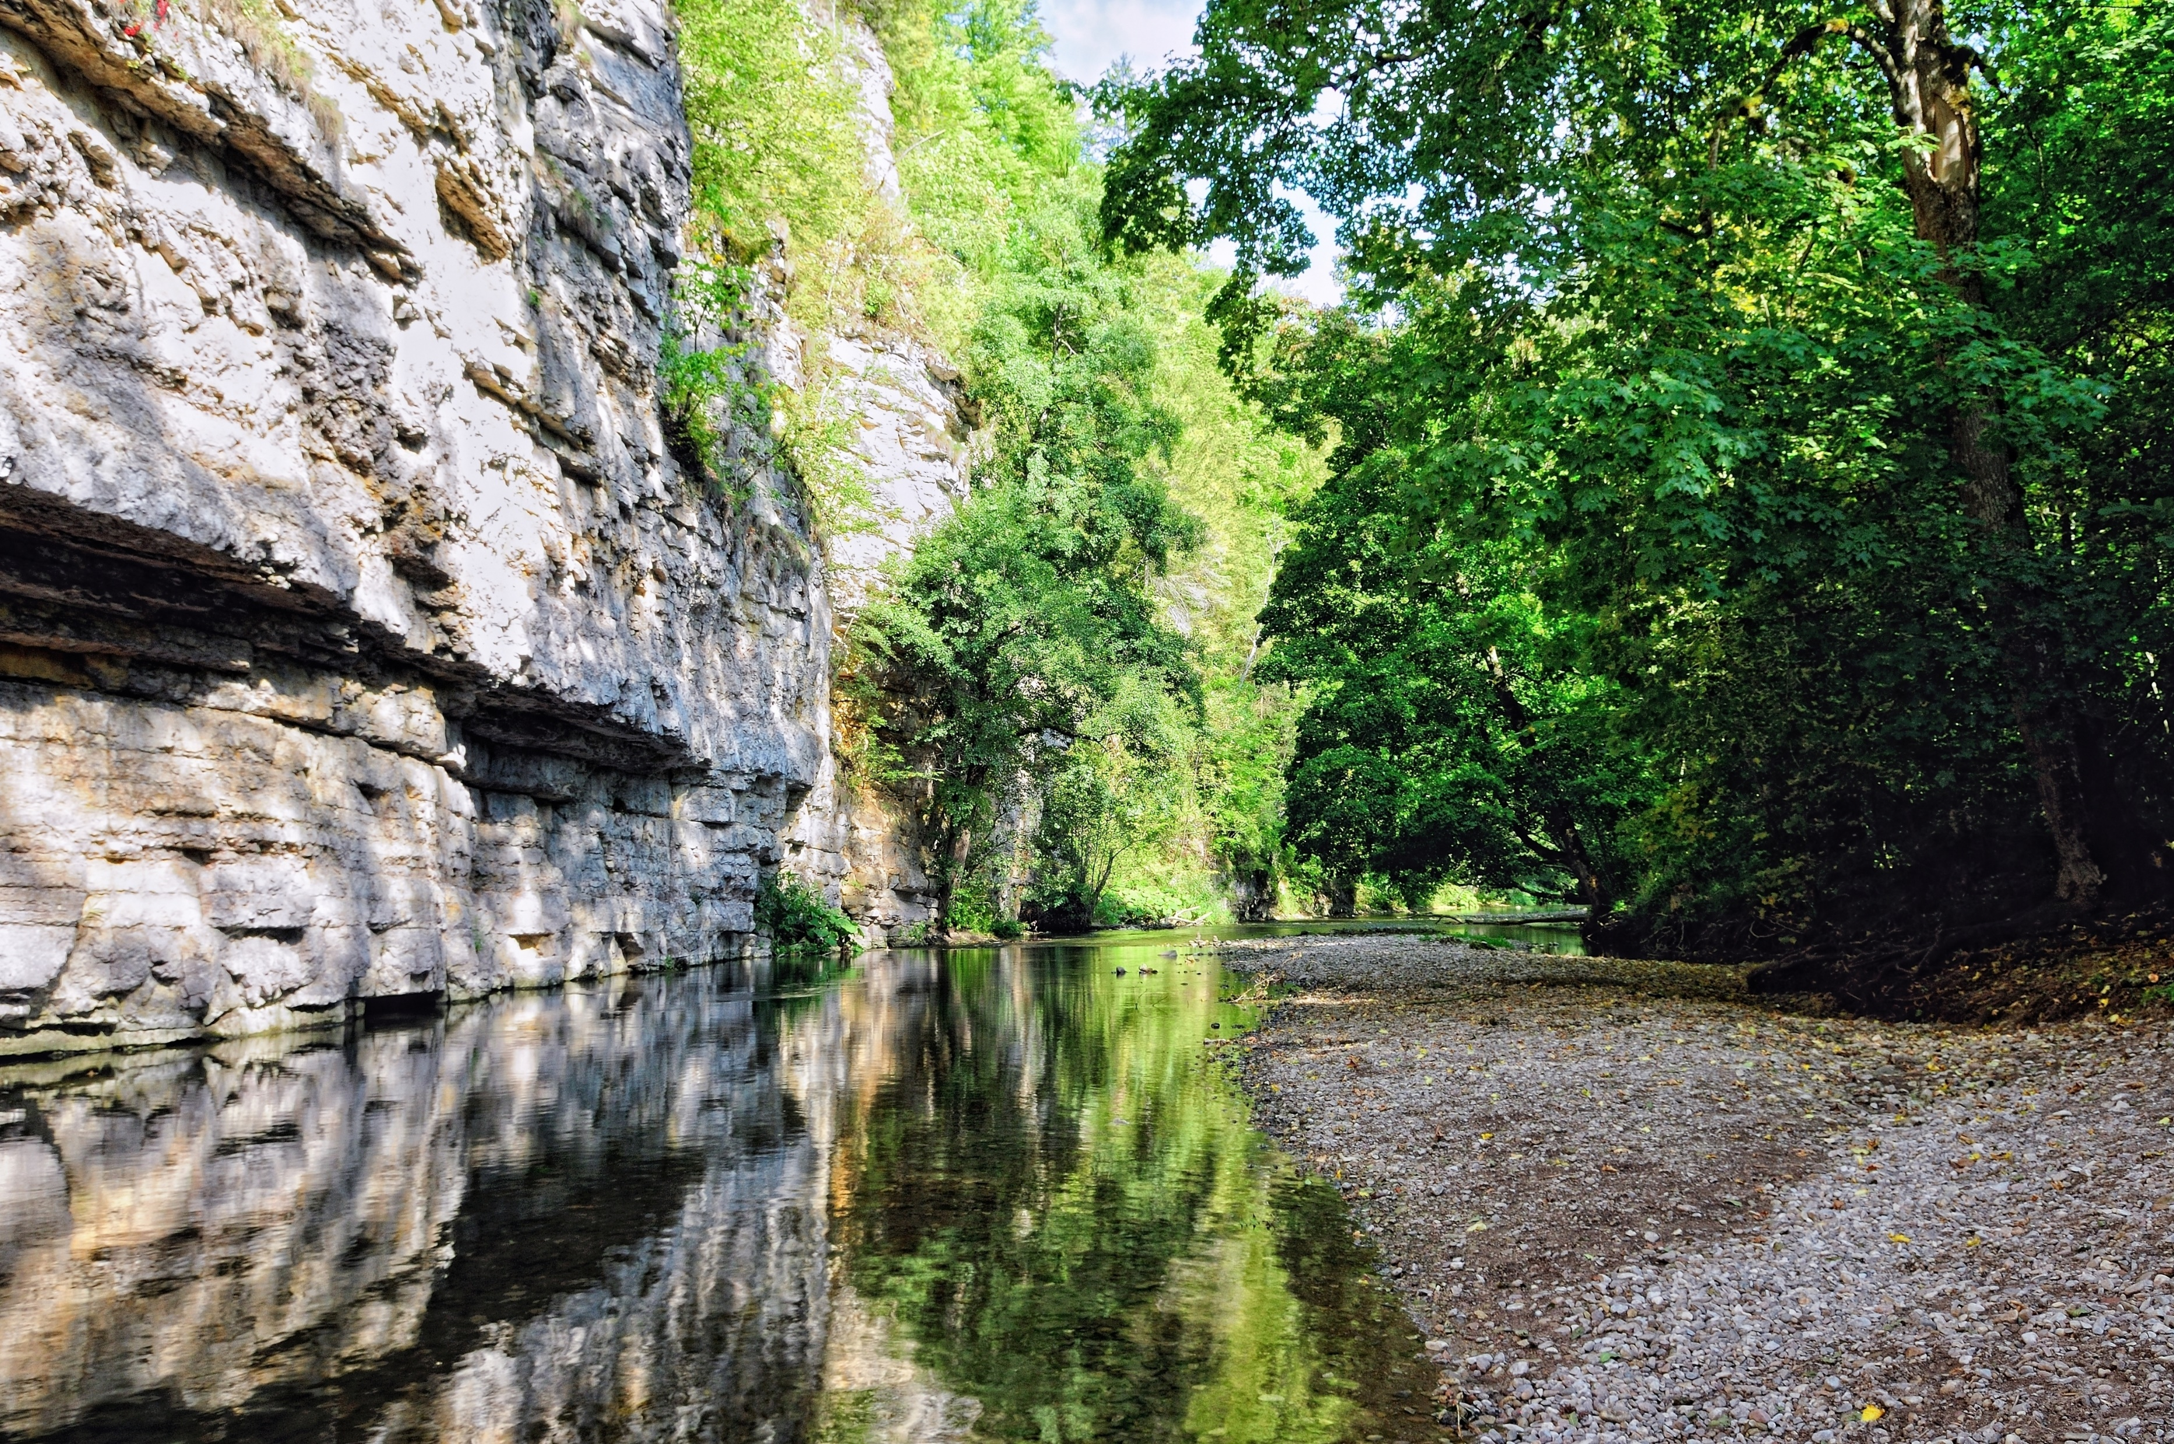
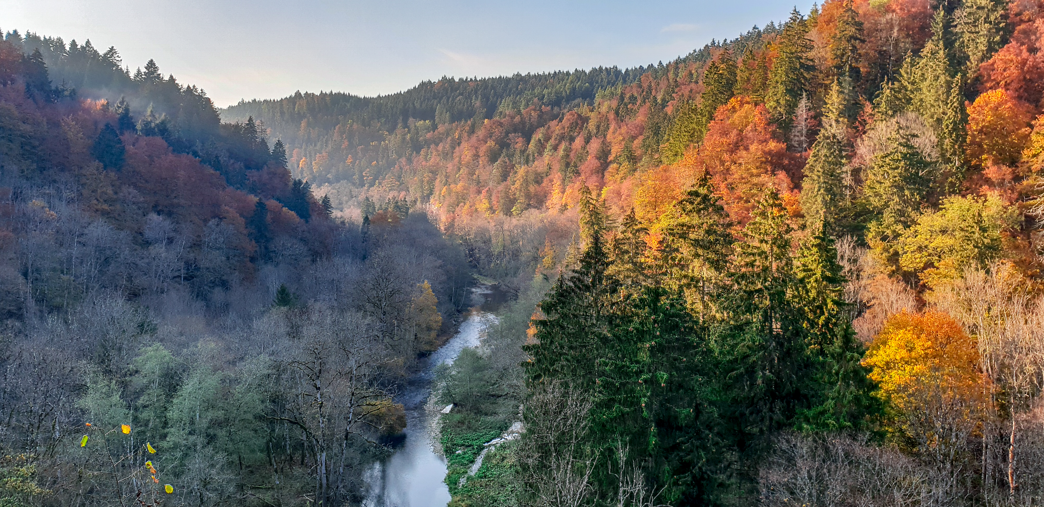
Wutach gorge, 160m incision in 18’000 years

Slide 11
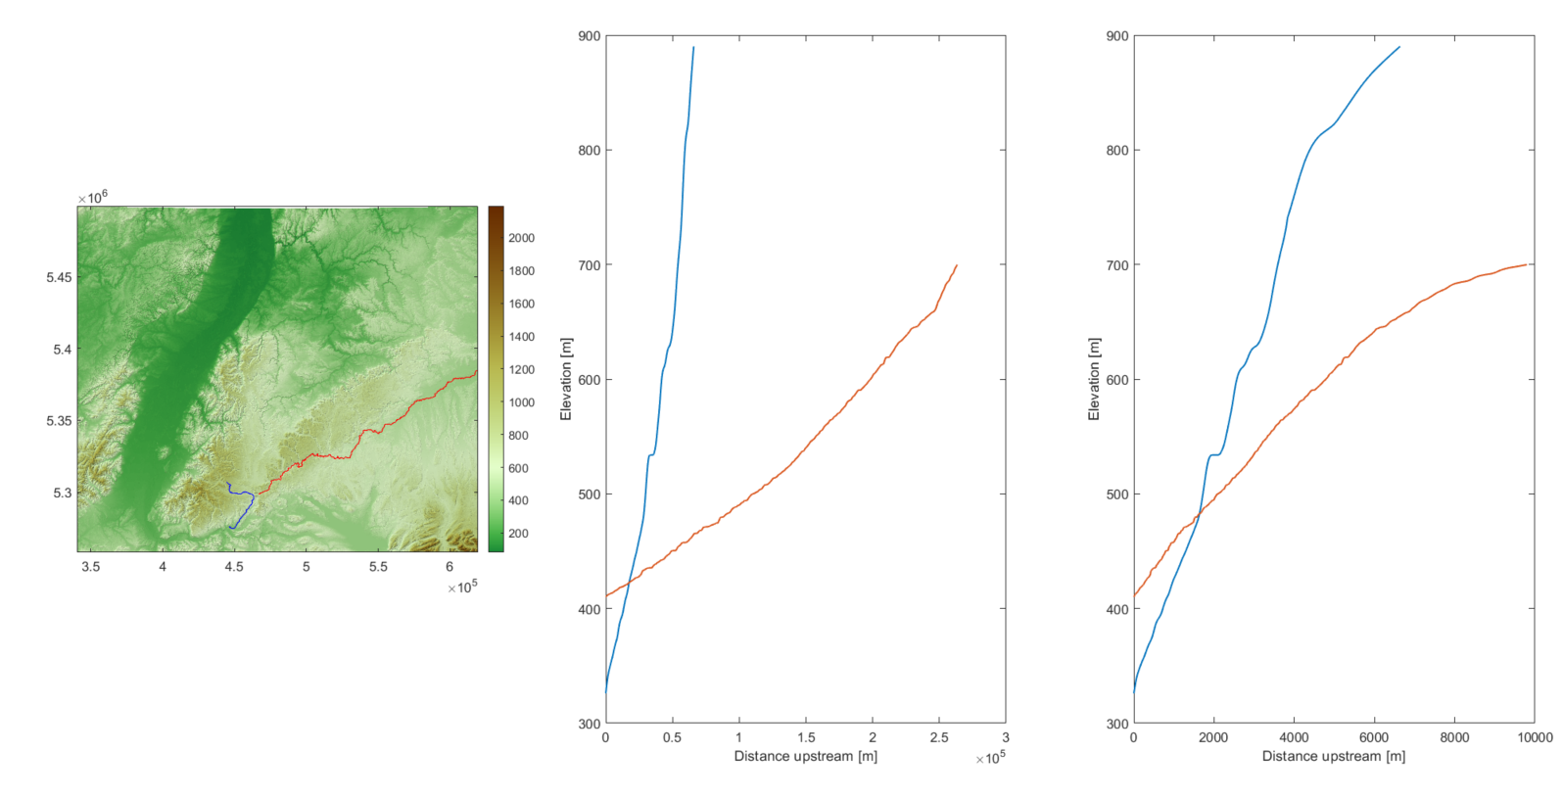
Paleoprofile of Danube
knickpoint
Parallel = same steepness

Slide 12
Paleoprofile of Danube
knickpoint
Capture point
What is the eroded volume?

Slide 13
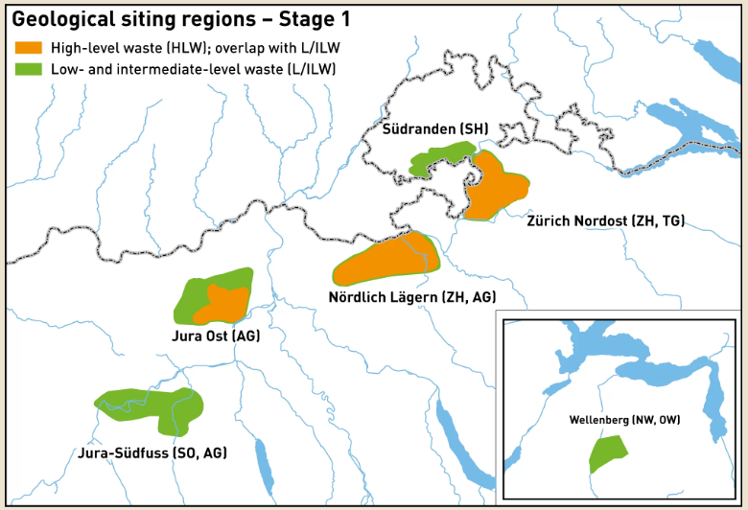
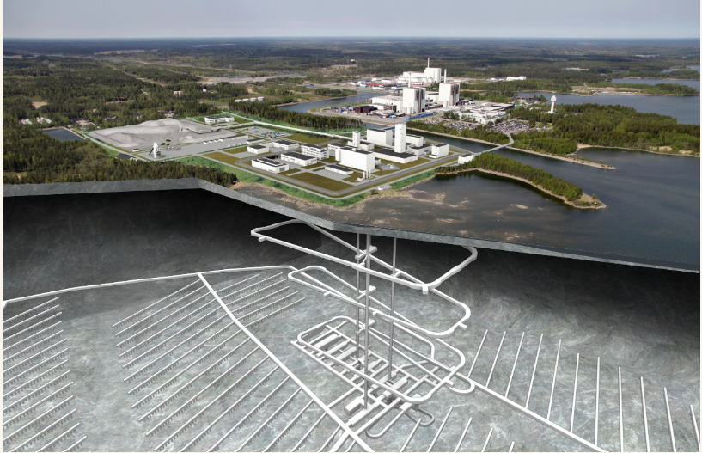
Why do we care how much erosion occurred?
Nuclear waste needs to be safely stored for 1 Mio years
Burial depth can’t be too deep (too hot down there to contain waste)
Erosion could cut into repository and expose waste
NAGRA

Slide 14
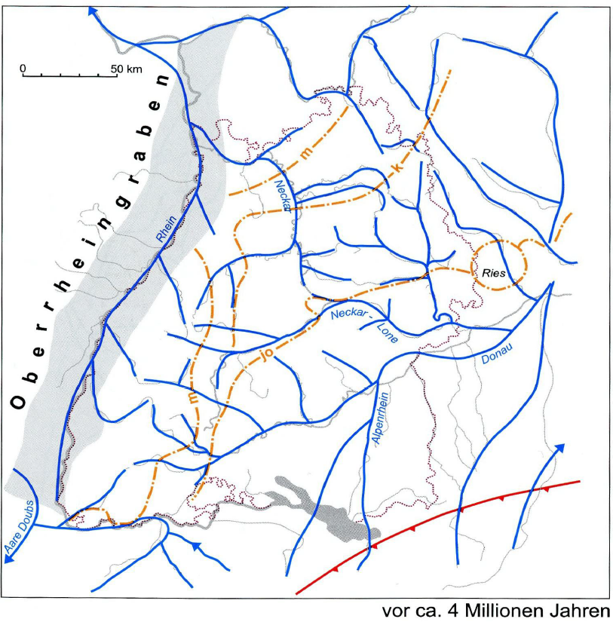
Drainage network of southwestern Germany 4 Mio years ago
Simon 2010

Slide 15
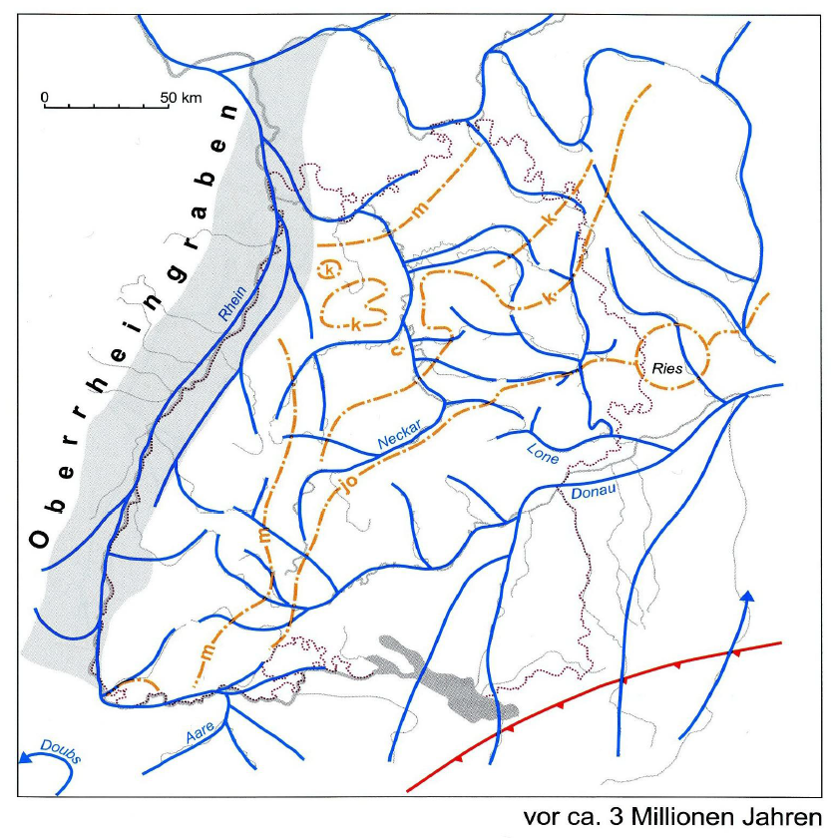
Drainage network of southwestern Germany 3 Mio years ago
Simon 2010

Slide 16
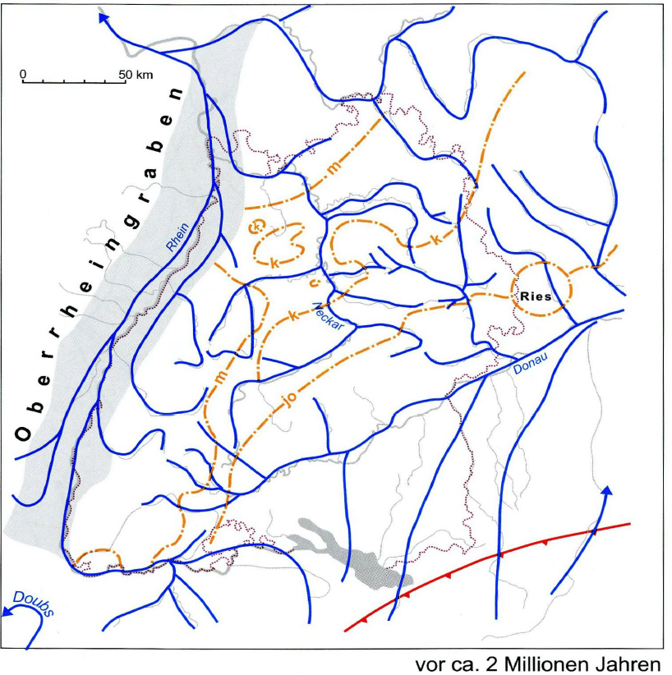
Drainage network of southwestern Germany 2 Mio years ago
Simon 2010

Slide 17
Donauversickerung

Slide 18
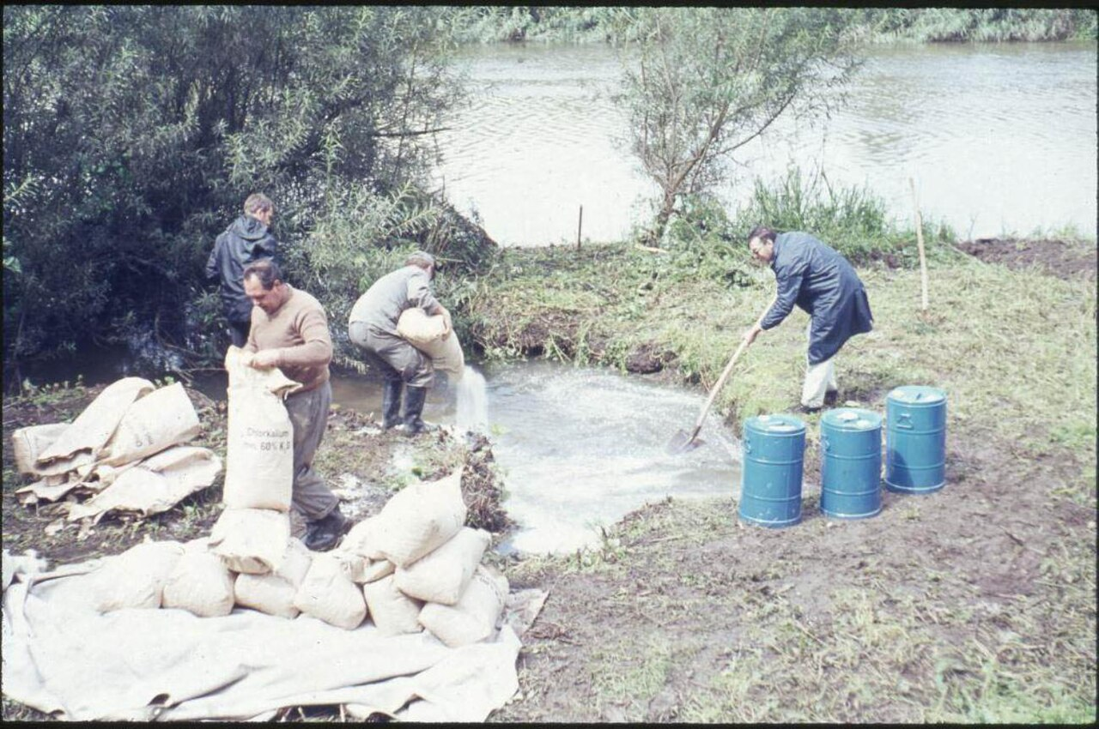
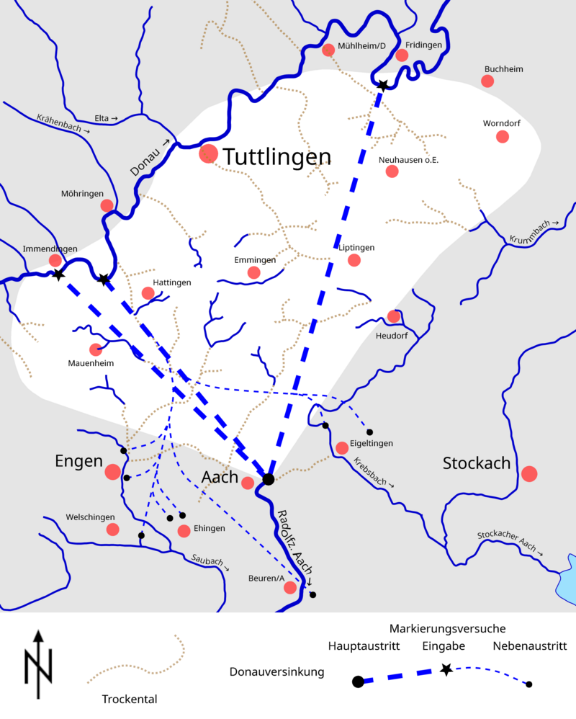
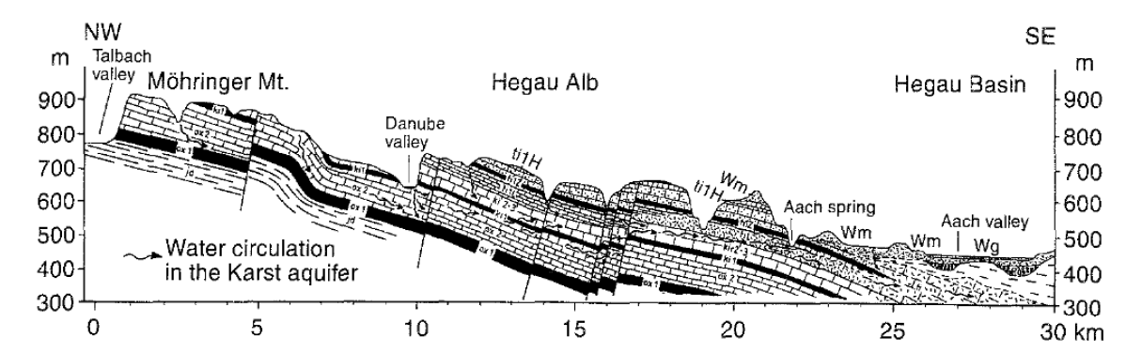
Kaess 2021
Partial underground river capture of Upper Danube

Slide 19
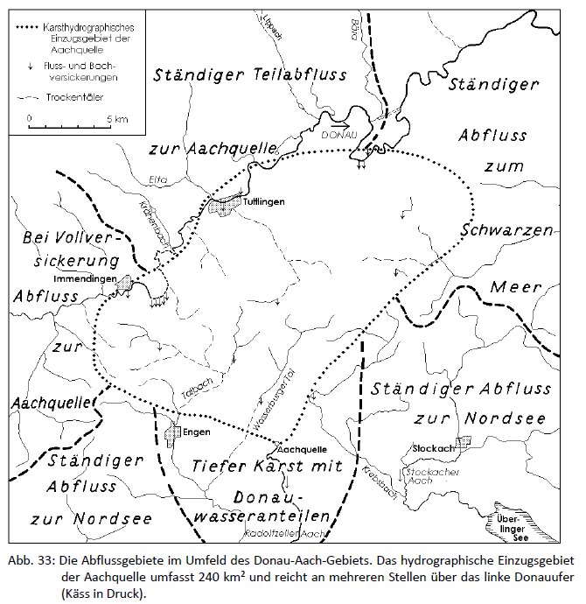
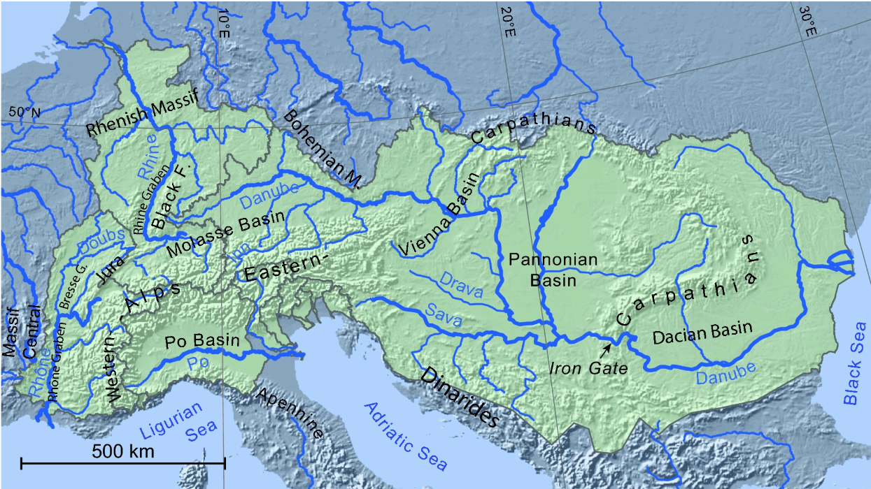
The drainage reorganization continues!
When will a new equilibrium be accomplished?
Kaess 2021

